Slide 1



Glacier velocity using microwave data
Instructor : Prof. Gulab Singh
Kapil Bhagat , Abhishek Anand , Dosapati Jayanth , Hemant Baddam Reddy Subbu Srikantam , Peram Ankshitha
TA - Ajay Chaudhary

Slide 2
Glacier velocity using microwave data
Content :
☑ Introduction
☑ Background
☑ Objective
☑ Study Area
Data Set
☑ Data Acquisition
☑ Methodology
Calculation
☑ Results
Future Work
Conclusion

Slide 3
Introduction
Importance of Glacier's :
Glaciers are an important part of our planet's ecosystem and play a crucial role in regulating the Earth's climate. Glacier velocity, which refers to the speed at which glaciers move, is an important parameter that helps us understand how glaciers respond to changing environmental conditions.
Furthermore, glacier velocity can also have important implications for human populations living in close proximity to glaciers. Rapidly moving glaciers can cause glacial outburst floods, which can be devastating for nearby communities. By monitoring glacier velocity, researchers can better predict and prepare for these events.
Overall, the study of glacier velocity using microwave data is a crucial aspect of understanding the behavior of glaciers and their impact on the Earth's environment.

Slide 4
Objective :
The objective of studying glacier velocity using microwave data is to accurately measure and understand the speed at which glaciers are moving over time.
This information can provide important insights into the dynamics and behavior of glaciers, such as how they respond to changes in temperature, precipitation, and other environmental factors. By studying glacier velocity using microwave data, scientists can also better predict and assess the potential impacts of glacier movement on sea level rise and water resources, as well as improve our understanding of climate change and its effects on the planet.

Slide 5
Background:
Microwave R emote Sensing(RS) uses E lectromagnetic radiation with a wavelength between 1 mm to 1 meter and frequency interval from 40,000 to 300 Hz. This covers the longest wavelengths used for remote sensing. Due to the greater wavelength compared to visible and infrared radiation, microwaves exhibit the important property of penetrating clouds, fog, and possible ash or powder coverages.
Microwave remote sensing is a valuable tool for estimating the velocity of moving objects, such as ocean currents, ice floes, and even vehicles. In this project, we utilized Synthetic Aperture Radar (SAR) data from the Sentinel-1 satellite to estimate the velocity of a target area.
Note: Here we are using the Rink Glaciers data for velocity estimation
Background

Slide 6
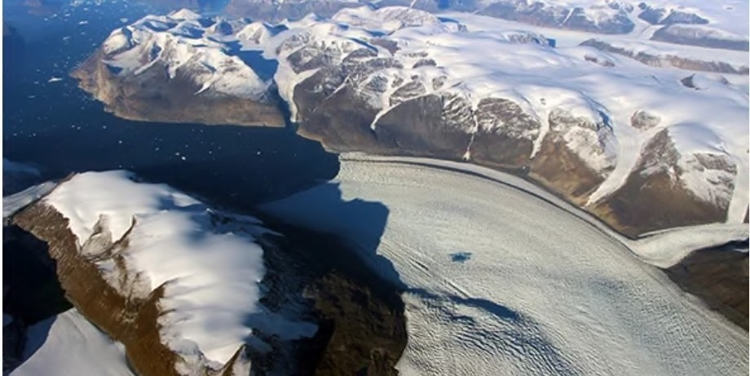
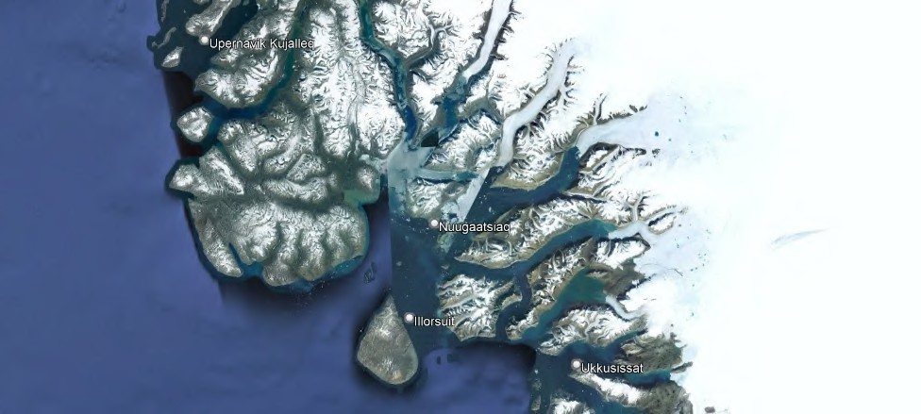

Study Area 1:
Microwave data is a useful tool for measuring glacier velocity, and the Sentinel Application Platform (SNAP) software can be used to process this data.
The Rink Glacier is located on the west coast of Greenland, and it is approximately 600 sq.km in size.
The glacier has been experiencing significant ice mass loss due to rising temperatures and melting ice. This makes it important to monitor its movement to understand its response to climate change and predict future sea-level rise.
Rink Glacier in Google Maps

Slide 7
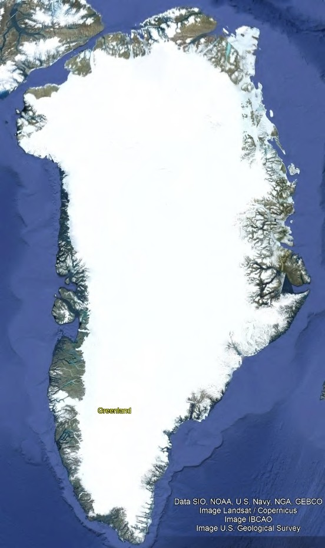
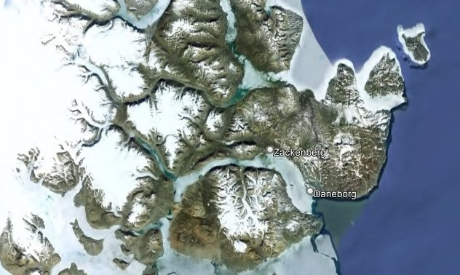
Study Area 2:
Greenland
Freya Glacier

Slide 8
Methodology:
Using Offset Tracking tools in generating glacier velocity maps with Sentinel-1 Level-1 Ground Range Detected (GRD) products. Offset Tracking is a technique that measures feature motion between two images using patch intensity cross-correlation optimization. It is widely used in glacier motion estimation.
Level-1 Ground Range Detected (GRD) products consist of focused SAR data that has been detected, multi-looked and projected to ground range using an Earth ellipsoid model such as WGS84. The ellipsoid projection of the GRD products is corrected using the terrain height specified in the product general annotation. The terrain height used varies in azimuth but is constant in range.
Note: Here we are using SNAP software for the whole process of generating glacier velocity maps

Slide 9
Data Acquisition :
Data Acquisition
Acquire microwave data from Sentinel-1 satellite
Pre - Processing
Apply radiometric calibration and remove noise correct for atmospheric effects
Image Co-Registration
Co-register two SAR images
Offset Tracking
The Offset Tracking to estimates the movement of glacier surfaces between master and slave images in both slant-range and azimuth direction

Slide 10
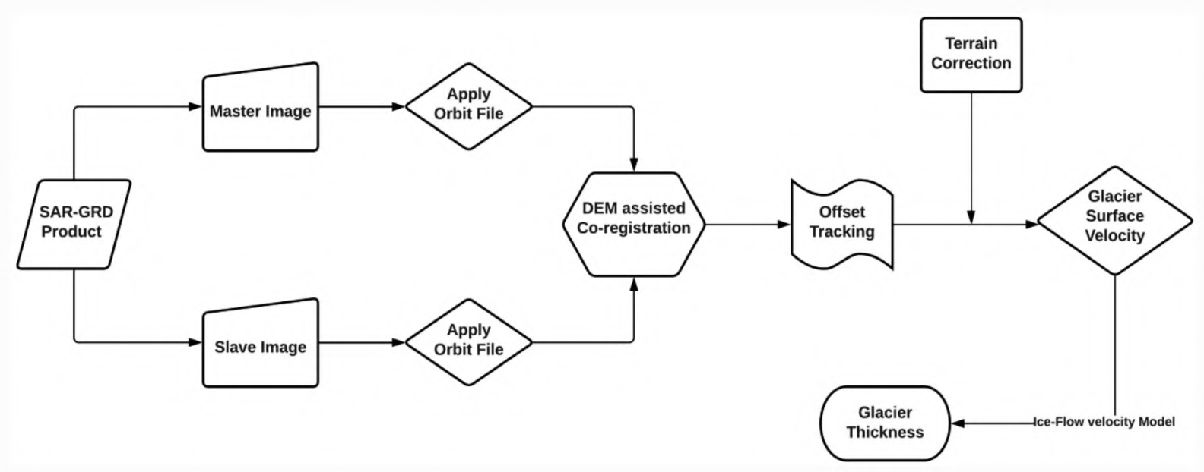
Flowchart of the velocity map generation

Slide 11
Data Acquisition:
The data used in this project was acquired using the Sentinel-1 satellite, which is equipped with a Synthetic Aperture Radar (SAR) that can operate in all weather conditions and provide high-resolution images of the Earth's surface.
Using the Vertex data portal (powered by Alaska Satellite Facility) to download the GRD products.
Sample 1: (12 days apart)
S1A_IW_GRDH_1SSH_20160708T204736_20160708T204801_012062_ 012A6D_D116
S1A_IW_GRDH_1SSH_20160720T204737_20160720T204802_012237_ 013014_9C25
Sample 2: (6 days Apart)
S1B_IW_GRDH_1SDH_20201020T182829_20201020T182854_023900_02D6CE_FD62
S1A_IW_GRDH_1SDH_20201026T182911_20201026T182936_034971_041424_1DAA
Data Acquisition

Slide 12
Data processing
☑ Phase Filtering and Unwrapping
Apply a phase filter and unwrap to obtain a continuous phase map
☑ Phase-to-Displacement Conversion and Geocoding
Convert phase values to surface displacement and geocode to obtain velocity map
☑ Filtering, Smoothing, and Visualization
Apply filters, remove outliers, and visualize velocity map
☑ Interpretation and Reporting
Interpret results and report findings
Note: All these processes are already done by the SNAP software

Slide 13
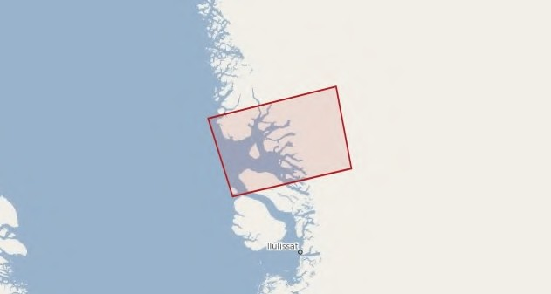
Products Explorer with World View Sample 1:

Slide 14
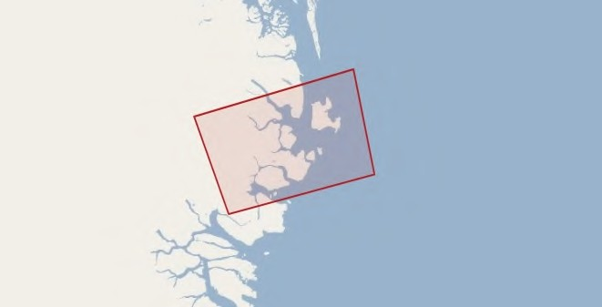
Products Explorer with World View
Sample 2:

Slide 15
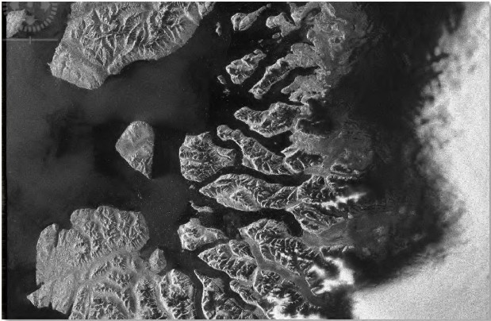
Amplitude_HH Band of Sample 1:
Comparing this image to the world map in slide 9, we will find that the image is flipped upside- down. This is because the image was acquired with an ascending pass and right-pointing antenna. Therefore, the bottom part of the image area was first sensed and in S1TBX, the first sensed line is always displayed on top of the image.

Slide 16
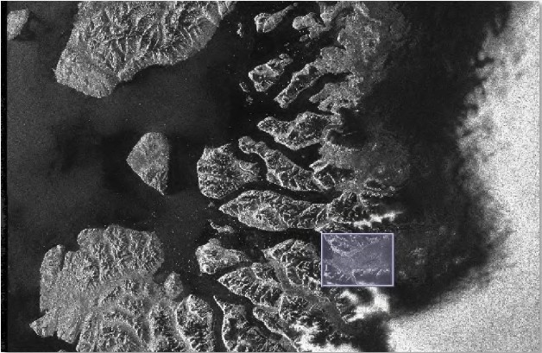
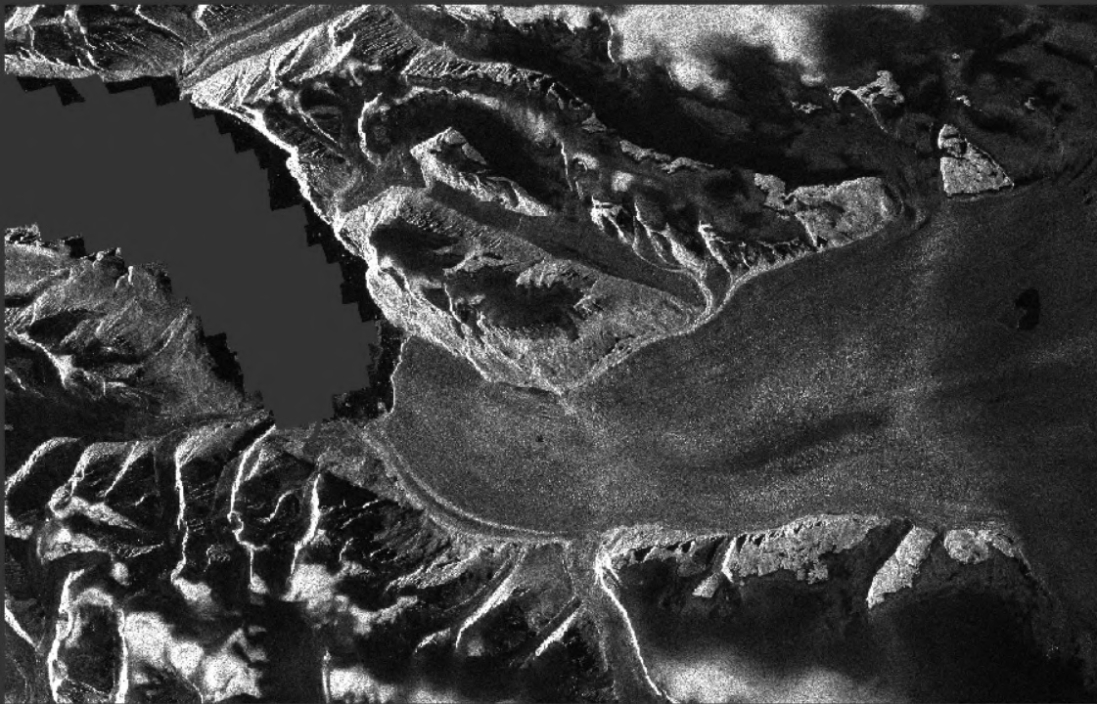
Create subset image containing Rink Glacier
Since the image covers a large area of the west coast of Greenland and we are interested only in the Rink Glacier area, we will create a subset of the coregistered stack that contains the Rink Glacier area only.

Slide 17
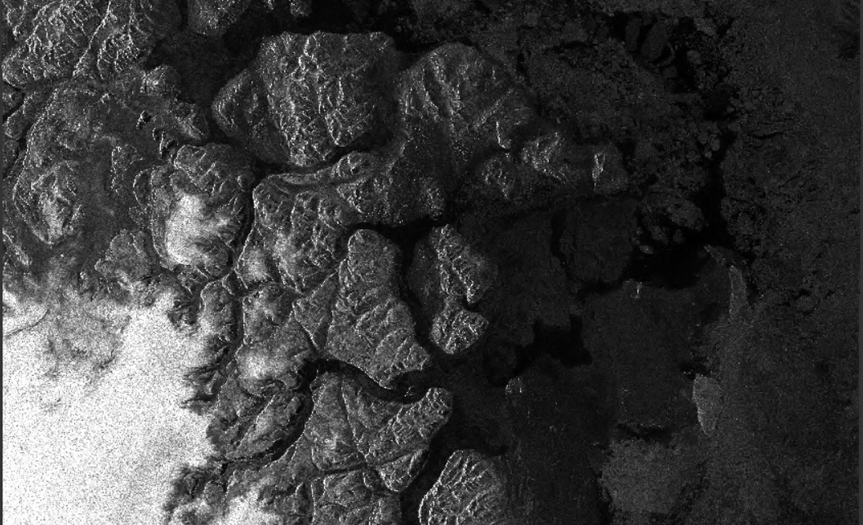
Amplitude_HH Band of Sample 2:

Slide 18
Offset Tracking:
The Offset Tracking operator estimates the movement of glacier surfaces between master and slave images in both slant-range and azimuth direction. It performs cross-correlation on selected Ground Control Point (GCP) in master and slave images. Then the glacier velocities on the selected GCPs are computed based on the offsets estimated by the cross-correlation. Finally, the glacier velocity map is generated through interpolation of the velocities computed on the GCP grid.

Slide 19
The Offset Tracking is performed in the following sub-steps:
•
For each point in the user specified GCP grid in master image, compute its corresponding pixel position in slave image using normalized cross-correlation.
If the compute offset between master and slave GCP positions exceeds the maximum offset (computed from user specified maximum velocity), then the GCP point is marked as outlier.
Perform local average for the offset on valid GCP points.
Fill holes caused by the outliers. The offset at a hole-point will be replaced by a new offset computed by local weighted average.
Compute the velocities for all points on GCP grid from their offsets.
Finally, compute velocities for all pixels in the master image from the velocities on GCP grid by interpolation.
•
•
•
•
•

Slide 20
Calculation behind the glacier velocity estimation using microwave data
Consider the following equation: v = λ/2π * ΔΦ/Δt
where:
•
•
•
•
v is the glacier velocity in meters per day
λ is the wavelength of the microwave signal (in meters)
ΔΦ is the differential phase shift between two SAR images (in radians)
Δt is the time interval between the two acquisitions (in days)
Note that additional processing steps, such as filtering and geocoding, may be necessary to obtain an accurate velocity estimate from the SAR data.

Slide 21
Calculation behind the glacier velocity estimation using microwave data
To estimate the differential phase shift (ΔΦ) between two SAR images acquired at different times. This is done by generating an interferogram, which is the result of subtracting the phase of one image from the other. The resulting differential interferogram contains information about the phase shift caused by the motion of the glacier between the two acquisitions
The differential phase shift (ΔΦ) is then converted to surface displacement using the following equation:
Δd = λ/4π * ΔΦ
where:
Δd is the surface displacement (in meters)
Finally, the glacier velocity (v) can be calculated by dividing the surface displacement (Δd) by the time interval (Δt) as shown in the first equation above

Slide 22
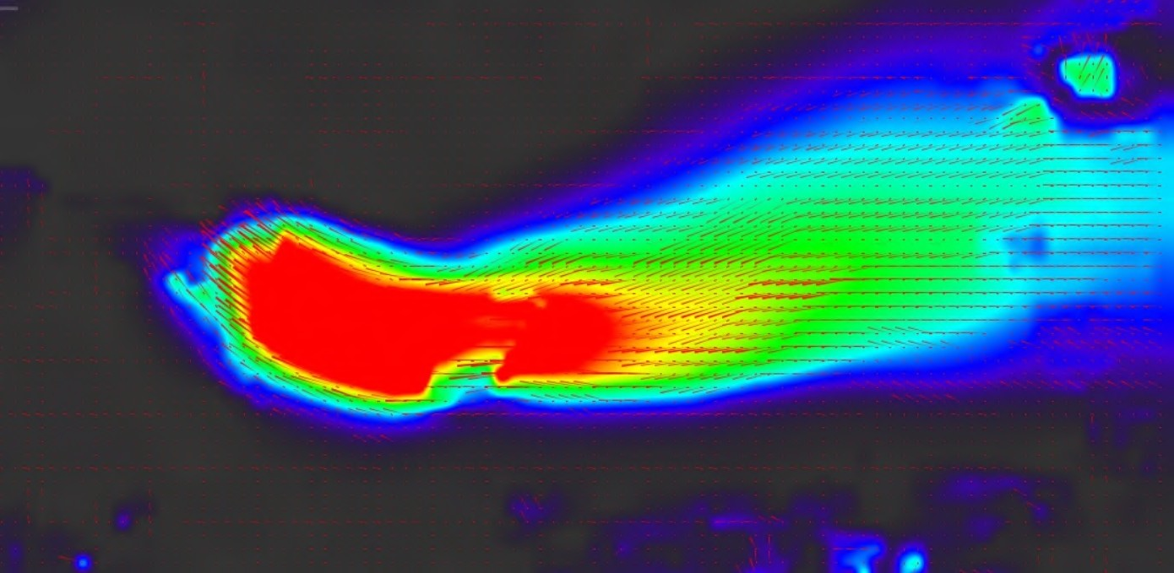
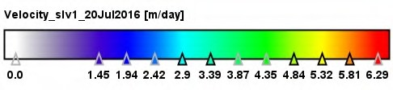
Obtained Result of Sample 1:
Velocity vectors on GCP grid; Contains modified Copernicus Sentinel data

Slide 23
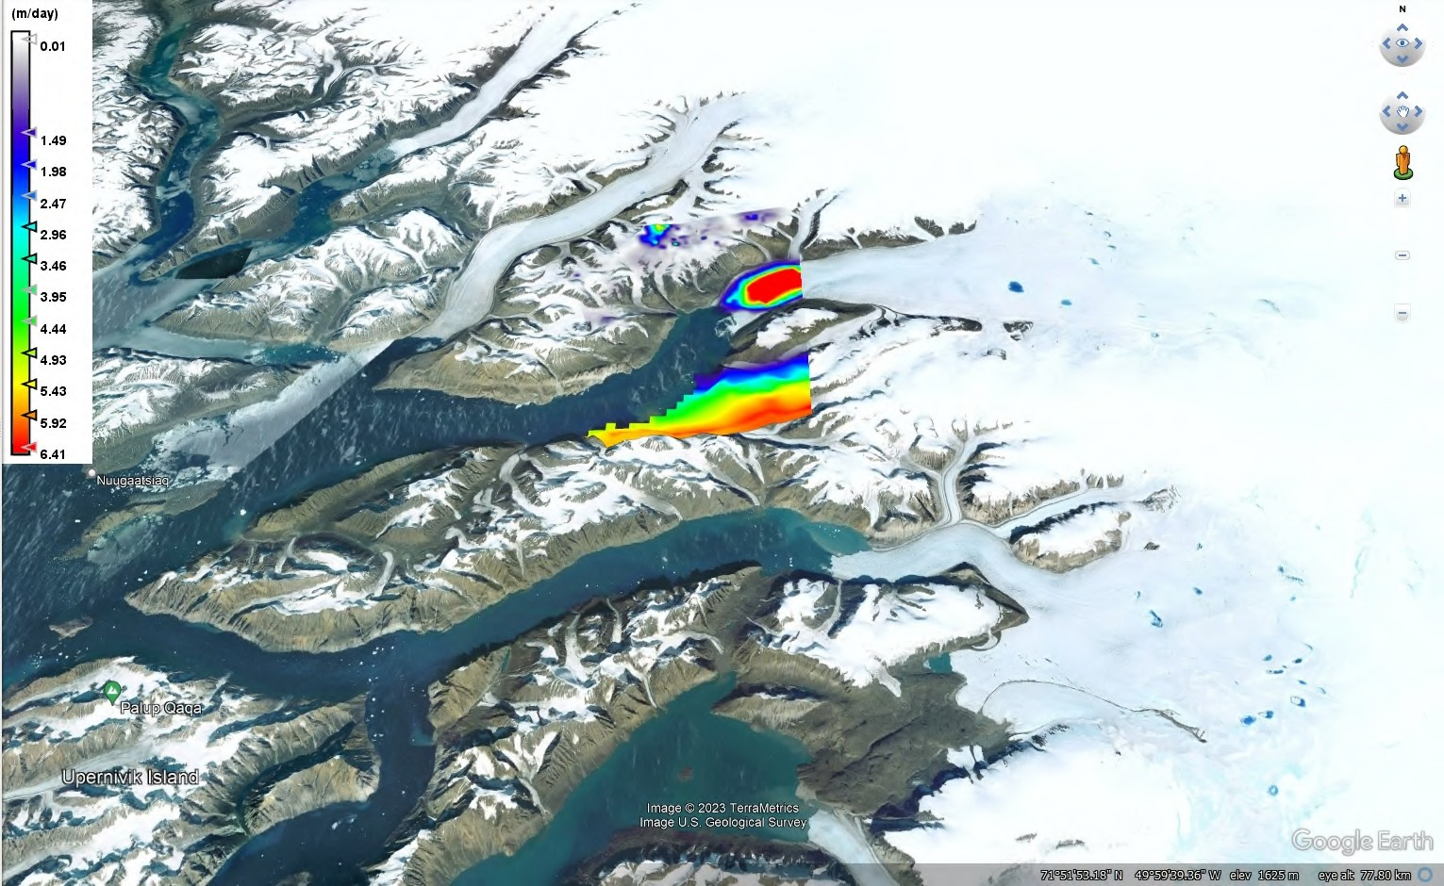

Slide 24
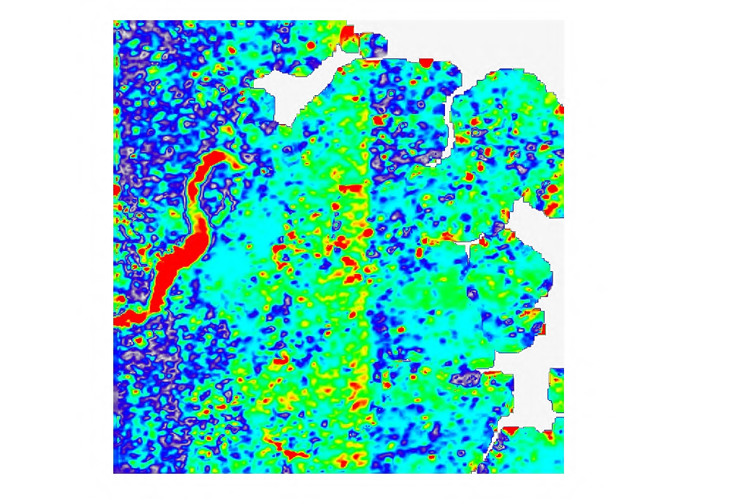
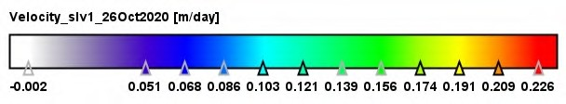
Obtained Result of Sample 2:

Slide 25
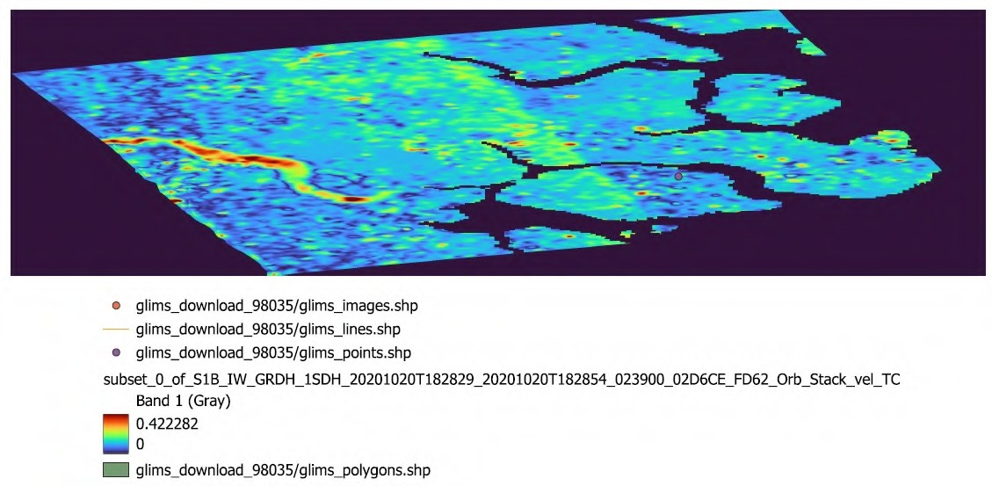
m/day

Slide 26
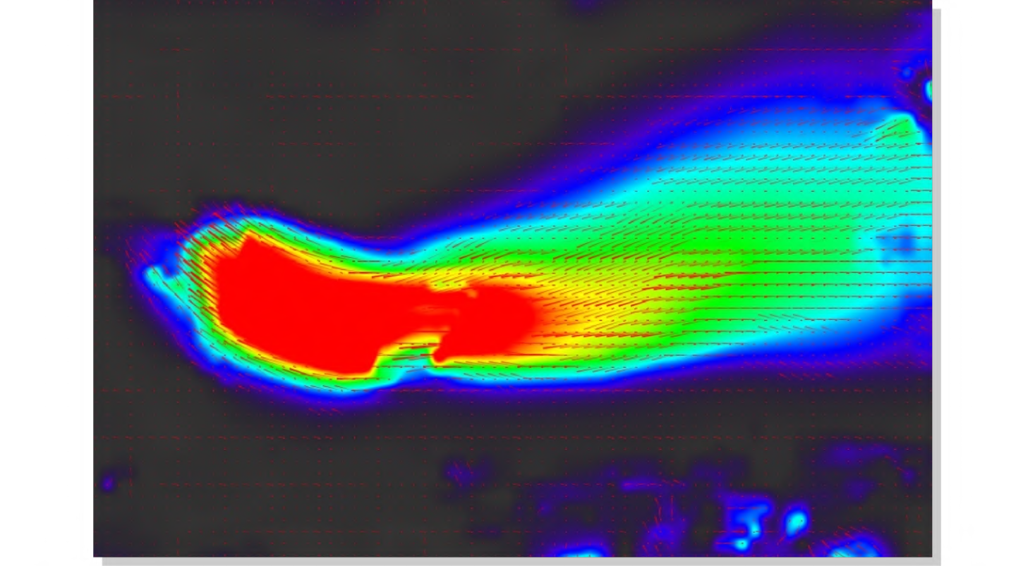
Conclusion:
Based on the analysis of the SAR data, we found that the velocity of Rink Glacier varies spatially and temporally. The velocity map shows that the glacier moves faster in the central and upper parts of the glacier, and slower towards the margins.
This pattern of velocity is consistent with the flow of ice towards the terminus of the glacier.
The velocity of Rink Glacier varies seasonally, with higher
velocities in summer and lower velocities in winter. This seasonal variability is attributed to the seasonal variations in temperature and precipitation, which affect the flow of ice
From the above two results we can see that Rink glaciers of Greenland flows with maximum velocity between 5 to 6 m/day while another Freya Glacier flows with velocity between 0.4 to 0.5 m/day.

Slide 27
Future Works:
We will validate our results using three pass and two pass interferometery techniques and we'll validate our data by field dataset also.

Slide 28
References:
https://scihub.copernicus.eu/dhus/#/home
https://www.researchgate.net/publication/329004897_Mapping_Surface_Flow_Velocities_of_Siachen_a
nd_Gangotri_Glaciers_Using_TerraSAR-X_and_Sentinel-1A_Data_by_Intensity_Tracking
https://asf.alaska.edu/how-to/data-recipes/how-to-create-glacier-velocity-maps-with-sentinel-1-toolbox/ https://www.youtube.com/watch?v=s7QzI2YEEJU
https://www.youtube.com/watch?v=HjCpMstVTVo

Slide 29
Thank you

